Slide 1

Cis 403 Capstone project
Musawir Mehfuz

Slide 2
Project outline
INTRODUCTION
SDLC
DESIGN ALGORITHM
OUTPUT
JIRA IMPLEMENTATION

Slide 3
Introduction
Good afternoon class Today I will be going over a project I worked on more since last time which was The ATM simulation, I decided to add more functions to it and using tkinkter producing a GUI interface that emulates a user bank account.

Slide 4


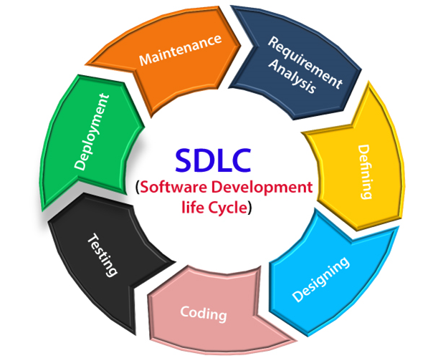
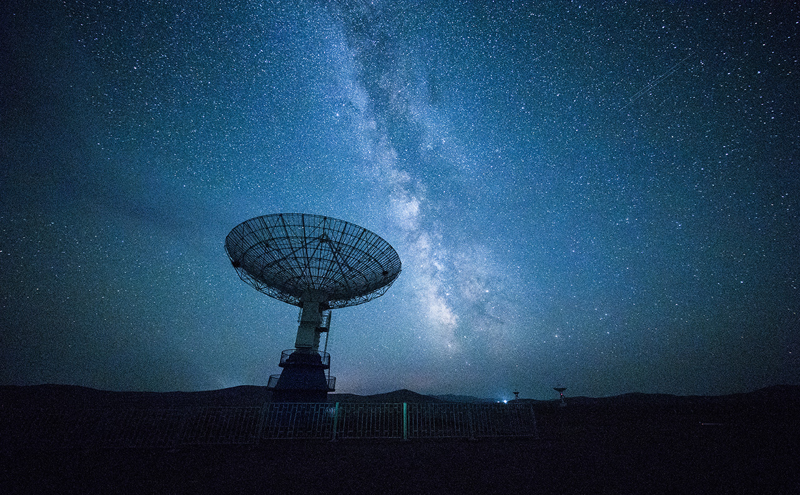
SDLC

Slide 5

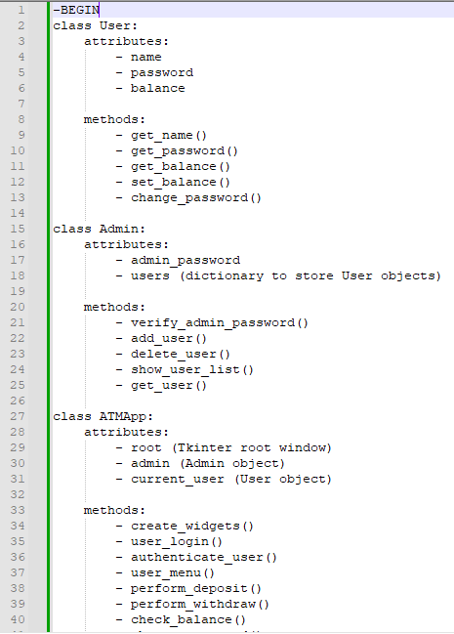
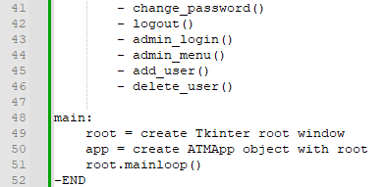
Design Algorithm

Slide 6
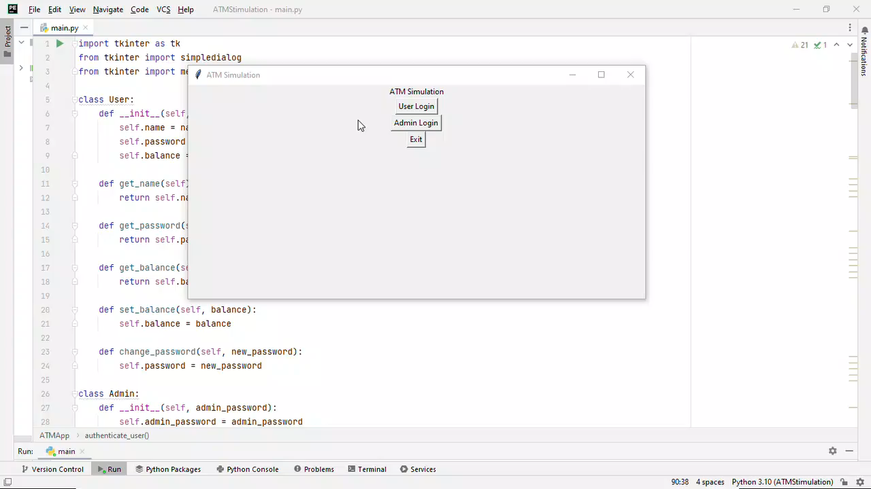
PROJECT OUTPUT

Slide 7
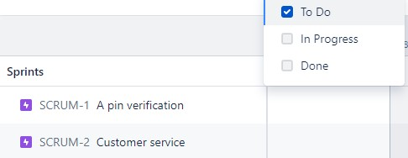
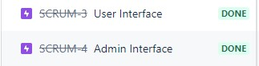
Jira implementation

Slide 8

Thank You!
Here is my linkedin: www.linkedin.com/in/mmehfuz7

